Slide 1
Cs-381 Software Engineering
Course Instructor: Dr. Shazia Arshad
Notes:
Welcome to all of you in this course. I am Dr. Shazia Arshad. I will be your instructor for this course.

Slide 2
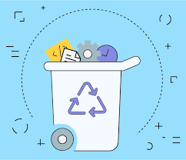
Lean model
Notes:
The Lean Development Methodology decrease Costs, Effort, and Waste. Lean software development is a set of principles that can be applied to software development to decrease programming effort, budgeting, and defect rates by one third. The principles were adapted from lean manufacturing by Mary and Tom Poppendieck. This approach is beneficial to an organization because agile iterations eliminate extensive pre-planned specifications. User stories rather than large upfront specs are easily understood by each team member and simpler to communicate.
“Lean development means removing all things unnecessary”
Lean development makes it possible to gain information straight from the source, therefore eliminating the common problem of producing software that does not address the customers’ needs. Short iterations provide an opportunity to communicate small sets of plans up front and allow the team to make decisions in order to adapt to unforeseen circumstances. Organizations that have the ability to complete fast, simple improvements in the shortest time frame gain powerful decision-making benefits.
Lean Artifacts:
All the activities in any industry are divided into Value Add (VA) or Non-Value Add (NVA).
Value-Add activities –
Are all the activities that physically improve a product or a service for customers – which means they are those activities that add value!
Non-Value Add (NVA) activities –
Are the activities that do not add value but are performed. The customer must bear the cost of NVA, and since it is not value add, a customer doesn’t want to pay for it.

Slide 3
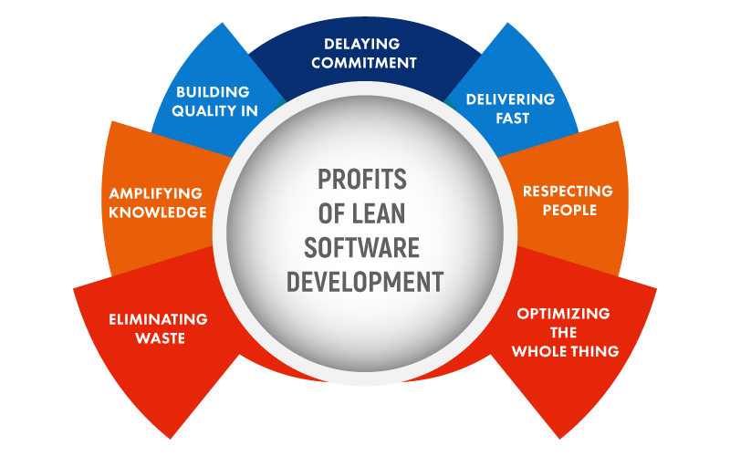
Principle of Lean model
Notes:
Lean Software Development Principles
Lean development methodology principles can be applied in any IT environment for improved programming practices. The practice is based on seven principles:
Eliminate waste – Spending time on adding real customer value(s)
Amplify learning – Increasing feedback to face tough problems
Decide as late as possible – Keeping options open as long as practical, but no longer
Deliver as fast as possible – Delivering value to customers as soon as they demand for it
Empower the team – Letting people who add value(s) to use their full potential
Build integrity in – Building product integrity into a system
Optimize the whole – Awareness to temptation to optimize parts at the expense of a whole system.

Slide 4
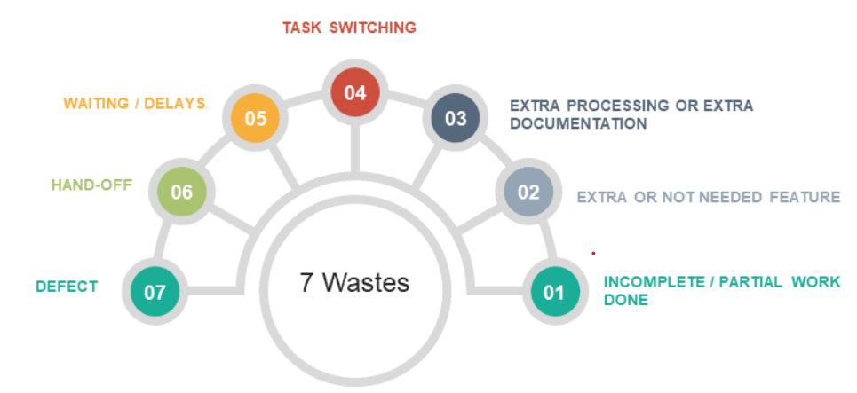
Concept of Waste
Notes:
1. Eliminate Waste
One of the key principles that make Lean a successful development process is the elimination of waste. Lean development is, in principle, about reducing waste as much as possible, be it in a development team, group, or organization. Examples of waste include excess inventory, unnecessary efforts, duplicated data, and most importantly, cost related to all the aforementioned.
In Lean, waste can be divided into seven major sections.
Incomplete/Partial Work Done
Work doesn’t add value to the customer until its complete, which, in turn, keeps the resources occupied. Moreover, until and unless it is not complete, we can’t figure out whether it will work or not.
Examples:
Incomplete coding documentation
Partial or incomplete code
Unverified code
How to reduce?
Try not to leave things unfinished
Limit and decide to complete work in progress
2. Extra or Not Needed Feature
A feature that has not been demanded by the customer, or is not suggested by the customer but comes as part of the package, is called Extra Feature. For example, if the scientific calculator is software, then there are many features like angles (sin, cos, tan), square root, etc. which might not be used by everyone but they come as a part of the package. Here comes the 80:20 rule in the software industry. It means 80% of the users, use only 20% of the features.
Example: At times, the client may be carried away with the latest technology and end up demanding a feature like a slider on a website, which will rarely be or not at all used by the end user.
How to reduce? Instead of worrying about how to develop stuff faster, it is far better to learn how to stop developing the things that are not important and focus on the things that will have the real impact.
3. Extra Processing or Extra Documentation –
Extra processing is incompetent or unnecessary additional process steps that add no value to the development process.
Examples:
Very detailed documentation
Extra management/planning activities
How to reduce?
Minimize extra activities
Plan as per requirement
4. Task Switching
Every time a person shuffles between tasks, there is a significant time that is required to gather the information, thoughts, and get into the new task. According to research, it takes a minimum of 15 minutes of concentration to enter flow, and during this time, you are not productive. Imagine – if a developer is interrupted two times a day, over half an hour of work is lost.
Example:
One person working on two projects
Developer interrupted for breaks for conversations over other projects.
How to reduce?
Minimize shuffling and assign resources to one project at a time
Eliminate what is not important
Minimize interruptions
Prioritize the activities
5. Waiting/Delays
There are some activities for which we need approvals, or there is some action required by some other team. Then this waiting for approval or waiting for information leads to waste referred to as “Waiting/Delay” waste.
Examples:
Waiting for inputs/information
Delays in approvals
Delayed testing
How to reduce?
Sitting in the same location as the client, this helps in quick approvals.
Face-to-face conversations
Regular feedback
6. Hand-off
Knowledge lost each time a deliverable/artifact is handed-off (analyst, designer, developer, and tester). While handing over, we can’t tell everything in detail no matter how much we try; some information would always be missing
How to reduce?
Less switching preferred
One person should be assigned one activity
The activity should be handed over to someone experienced in the same field
7. Defect
Defect resolution takes a lot of time, first wait till it is recognized and then wait for the resolution. The expenses which are incurred on fixing a defect at an early stage are significantly lower than those identified after the product has been delivered.
How to reduce
Testing as early as possible

Slide 5
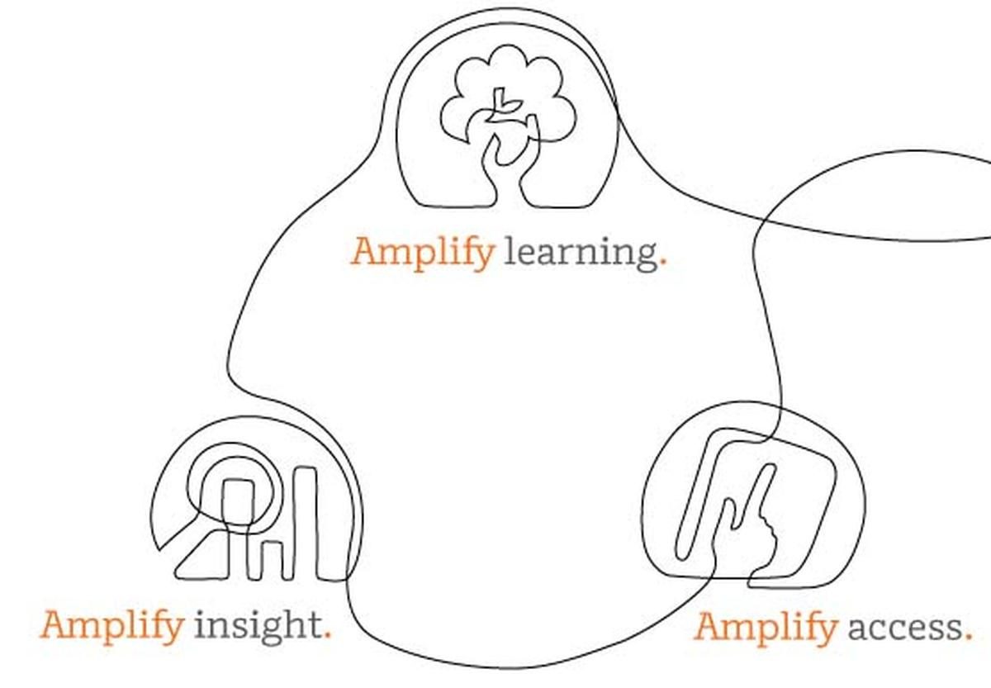
Amplify Learning
Notes:
When it comes to a successful project, knowledge plays a significant role in the success of the project. Learning is an ongoing process that never completes. We need to keep learning from everything we code, test, deliver, and discard. We need to keep this knowledge available for everyone by sharing and storing it at some common place like a shared drive or LMS which, in turn, allows everyone in the system
To learn things that did well in the past.
To avoid things that did not work well in the past.
Lean software development is considered as an ongoing learning process. Developers do not usually write clear code on the first try. After having detected and fixed errors, they write an improved variation of the previous code. In other words, developers gain knowledge during development by solving problems and producing code variations. Thus, the best approach to improve the software development is writing code and building instead of documentation and detailed planning

Slide 6
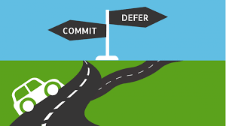
Defer Decision
Notes:
In the software development industry, most of the decisions have a direct impact on the project. We can always try to delay the decisions until they are based on facts because corrections are difficult in the software industry, as we may need approvals and it may cost us money as well. The lean master can defer decisions to avoid this.
For restaurant example – in case any customer complains that the food is too spicy. You know whom to question. But you can’t take decisions then and there; you need to check the facts and try to solve the problem, which is more important than making some harsh decisions.

Slide 7
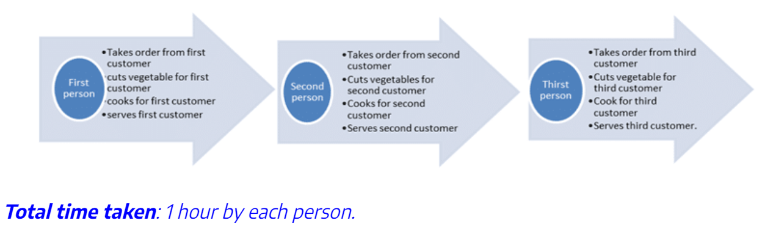
Fast Delivery
Notes:
Agile development techniques focus on delivering software as fast as possible. Lean development being an agile approach also emphasizes fast software delivery. It means that a project team has to deliver a targeted component to users at the right time. For your team, create even and stable workflows that come from understanding the process value to facilitate faster results.
In Lean, we identify steps which are slowing us down, eliminate them as it will help us in fast delivery of software solution to the client. In Lean, we develop and deliver software solutions, incrementally to the client. Lean Project Leader keeps a track and ensures timely delivery.
For restaurant example – we have taken a case where we have made two different processes:
Process 1:
Total time taken: 1 hour needed to serve each person.
If only one worker performs tasks.

Slide 8
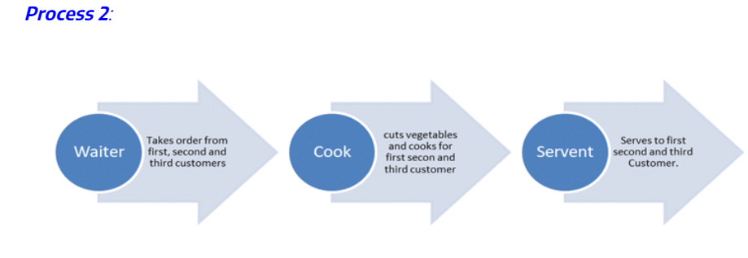
Fast
Delivery
Notes:
Process 2:
Total time taken: 30 mins
It is quite evident that Process 2 has a clear edge over Process 1 because
As all the workers are getting utilized, so there is no waste in the process.
It took only 30 minutes to serve food to the customer in Process 2 as compared to one hour in Process 1, therefore, leading to fast delivery as well.

Slide 9
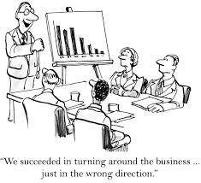
Empower Team /
Respect for people
Notes:
The Lean principle of Respect for People is often neglected especially in the fast-paced, burnout-ridden world of software development. It applies to every aspect of the way Lean teams operate, from how they communicate, handle conflict, hire and onboard new team members, deal with process improvement, and more. Lean development teams can encourage respect for people by:
Communicating proactively and effectively
Encouraging healthy conflict
Surfacing any work-related issues as a team
Empowering each other to do their best work

Slide 10
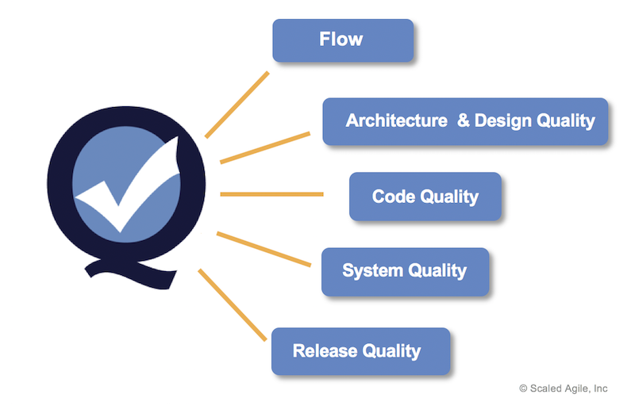
Build in Quality
Notes:
In the software development industry, your objective should be to maintain quality from the beginning and not test it in later stages. For instance, in the first place, the developer should try to develop smooth and bug-free coding. If any bug still appears during testing for resolution, the developer needs to ensure that
The resolution of bug takes place.
A thorough root cause analysis has been carried out.
He takes down the details for the future reference.
The reason being, if the same bug is there in some other scenario, then it can be fixed during the development stage itself.
Example
In the case of our restaurant example, one of the basic expectations of the customer from the quality perspective is “hygiene” so it is of utmost importance that all utensils are thoroughly cleaned in which the food gets served. Restaurant management would like to avoid any risk on account of “hygiene,” so they opted for a dishwasher machine, thereby, eliminating the potential risk of customer complaints on account of dirty dishes.

Slide 11

Optimize the Whole
Notes:
In software development organizations, developers may feel pressurized to meet stringent timelines and end up writing sloppy code, which may result in more defects. This, in turn, increases the workload for developers only. Similarly, if testers are overburdened with work, they will not be able to share their findings with developers on time. In the meanwhile, developers keep on writing code thereby increasing backlog for testers. An organization can easily overcome these situations by having a better understanding of their tester’s/developer’s capacity.
Example:
For example, the restaurant observes more customers during the festive season. There is an ever-mounting pressure on the chef to cater to all these orders on time. As a result, he missed out on keeping the right balance of spices in 2-3 dishes, resulting in returned orders. This further causes rework for the chef as well as for the person who is responsible for serving. To ensure quality, avoid rework and timely delivery, restaurant management may put a threshold on the maximum number of customers which they are going to cater to at any given point of time. As soon as the number of customers reaches this threshold limit, the restaurant is not going to accept any more orders/customers, which helps in optimizing productivity, quality of production, and your business as a whole.

Slide 12


PROS AND CONS
Notes:
Advantages of lean model:
The development process becomes simplified and rational. LSD removes needless process stages when designing software, saving time and valuable resources as a result.
Eliminating wasteful losses. As the focus is on the minimum viable product, LSD prioritizes essential functions and features above all else. Once an MVP is in the marketplace, teams can then learn which new features should take priority, based on real customer insight — this removes the risk of spending time or investment on needless builds.
Boost the involvement rate of your team. When understanding the values in lean development methodology, people are one of the most important keys. By increasing participation, the overall workflow becomes optimized, and losses get reduced or removed altogether.
Disadvantages of lean model:
Equipment Failure - Lean has very little room for error.
Documentation is critical. Failure to thoroughly record and document the LSD process can lead to mistakes in the development process.

Slide 13

ANY QUERY
Notes:
Discuss the difference between agile and lean methodology if any?

